Slide 1
Instructions for using this template.
Rules:
Students will be divided up into 3 groups
One student from each group will come up to the buzzers for each question
The team who had last pick or answered the last question correctly had the board
When the question is being asked, all students will be quiet and attentive
Their will be no penalty for a wrong answer, except for an incorrect daily double or incorrect final jeopardy
Students will be allowed to keep their notes out, but will not be able to use them when answering questions
Other group members may not help the person at the buzzer answer any questions, except in final jeopardy.

Slide 2
Jeopardy
Choose a category.
You will be given the answer.
You must give the correct question.
Click to begin.

Slide 3
Choose a point value.
Choose a point value.
Click here for Final Jeopardy

Slide 4
Countries
Countries
Countries
Country
And
Cities
Cities
10 Point
10 Point
10 Point
10 Point
10 Point
20 Points
20 Points
20 Points
20 Points
20 Points
30 Points
30 Points
30 Points
30 Points
30 Points
40 Points
40 Points
40 Points
40 Points
50 Points
50 Points
50 Points
50 Points

Slide 5
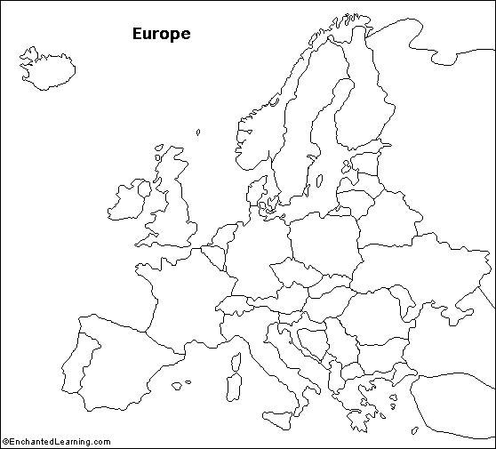

Slide 6
What is Spain?

Slide 8
What is Germany?

Slide 10
What is Denmark?

Slide 12
What is the Ukraine?

Slide 14
What are the Bulgaria?

Slide 16
What is the United Kingdom?

Slide 18
What is Iceland?

Slide 20
What is Latvia?

Slide 22
What is Albania?

Slide 24
What is Serbia?

Slide 26
What is Finland?

Slide 28
What is The Netherlands?

Slide 30
What is Switzerland

Slide 32
What is Slovakia?

Slide 34
What is Croatia?

Slide 36
What is Romania?

Slide 38
What is Rome?

Slide 40
What is Athens?

Slide 42
What is Paris?

Slide 44
What is Stockholm?

Slide 46
What is Budapest?

Slide 48
What is Dublin?

Slide 50
What is Warsaw?

Slide 55
Final Jeopardy
Category:
Make your wager

