Slide 1
Instructions for using this template.
Rules:
Students will be divided up into 3 groups
One student from each group will come up to the buzzers for each question
The team who had last pick or answered the last question correctly had the board
When the question is being asked, all students will be quiet and attentive
Their will be no penalty for a wrong answer, except for an incorrect daily double or incorrect final jeopardy
Students will be allowed to keep their notes out, but will not be able to use them when answering questions
Other group members may not help the person at the buzzer answer any questions, except in final jeopardy.

Slide 2
Jeopardy
Choose a category.
You will be given the answer.
You must give the correct question.
Click to begin.

Slide 3
Choose a point value.
Choose a point value.
Click here for Final Jeopardy

Slide 4
Islands
&
Peninsulas
Rivers
Seas
Land
10 Point
10 Point
10 Point
10 Point
20 Points
20 Points
20 Points
20 Points
30 Points
30 Points
30 Points
30 Points
40 Points
40 Points
40 Points
40 Points
50 Points
50 Points
50 Points
50 Points

Slide 5
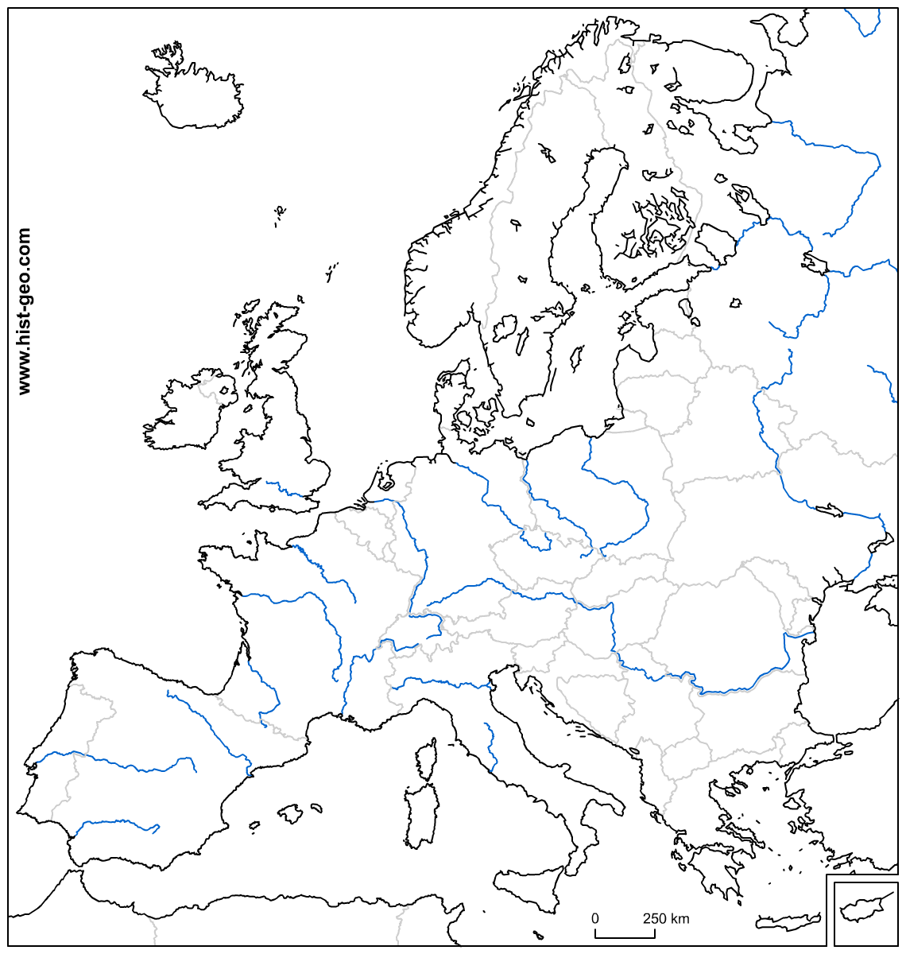

Slide 6
What is Ireland?

Slide 8
What is Iceland?

Slide 10
What is the Scandinavia
&
Italian Peninsulas?

Slide 12
What is Crete?

Slide 14
What are Sardinia?

Slide 16
What is the Thames River?

Slide 18
What is the Rhine River?

Slide 19
.

Slide 20
What is the Danube River?

Slide 22
What is the Tagus River?

Slide 24
What is the Dnieper?

Slide 26
What is the English Channel?

Slide 28
What are the Black Sea?

Slide 30
What is the Baltic Sea?

Slide 32
What is the Strait of Gibraltar?

Slide 34
What is the Bay of Biscay?

Slide 36
What are the Alps?

Slide 38
What is the Northern European Plain?

Slide 40
What are the Pyrenees?

Slide 42
What are the Carpathian Mountains?

Slide 44
What is the Hungarian Plain?

Slide 55
Final Jeopardy
Category:
Make your wager

